Slide 1
All the World’s a Stage [Poem]
-William Shakespeare

Slide 2
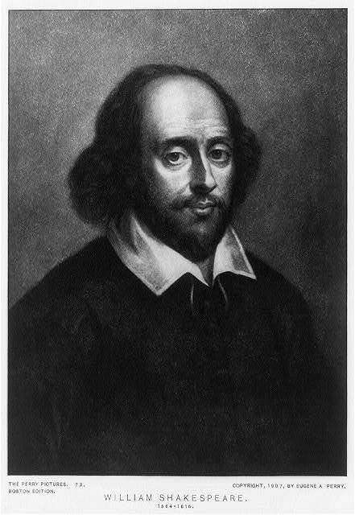
Before Reading
Answer these questions.
How does life begin?
Do you think that the whole world is a stage?
Are we the actors in the world?
What roles can a person play in his/her life?

Slide 3
Overview
[Page. 240]
About the poet
Summary
Explanation to the poem
Analysis of the poem
Themes
Conclusion
Exercises

Slide 4
About the poet
[Page. 240]
Shakespeare
Died in 1616
English poet, playwright, actor
Known as the dramatist of all time
Born in 1564
Hamlet, Othello, King Lear, Romeo and Juliet and Macbeth.

Slide 5
About the poem
[Page. 240]
"All the world's a stage" is the phrase that begins a monologue from William Shakespeare’s comedy play As You Like It, spoken by the melancholy Jaques in Act II.
The speech compares the world to a stage, and life to a play and classifies the seven stages of a man's life, sometimes referred to as the seven ages of man.

Slide 6
All the world's a stage,
And all the men and women merely players;
They have their exits and their entrances,
And one man in his time plays many parts,
His acts being seven ages. At first, the infant,
Mewling and puking in the nurse's arms.
Then the whining schoolboy, with his satchel
And shining morning face, creeping like snail
Unwillingly to school. And then the lover,
Sighing like furnace, with a woeful ballad
Made to his mistress' eyebrow. Then a soldier,
Full of strange oaths and bearded like the pard,
Jealous in honour, sudden and quick in quarrel,
Seeking the bubble reputation
Even in the cannon's mouth.
[Page. 240]

Slide 7
And then the justice,
In fair round belly with good capon lined,
With eyes severe and beard of formal cut,
Full of wise saws and modern instances;
And so he plays his part.
The sixth age shifts Into the lean and slippered pantaloons,
With spectacles on nose and pouch on side;
His youthful hose, well saved, a world too wide
For his shrunk shank, and his big manly voice,
Turning again toward childish treble, pipes
And whistles in his sound. Last scene of all,
That ends this strange eventful history,
Is second childishness and mere oblivion,
Sans teeth, sans eyes, sans taste, sans everything.
[Page. 240]

Slide 8
Summary:
[Page. 240]
This poem is from Shakespeare’s famous play “As You Like It”.
The speaker, Jacques, begins “All the world’s a stage” by stating that life is like a stage on which “men and women merely” play roles.
They play different parts throughout their lives, as the speaker is now.
The seven stages are: an infant crying, a whining school boy, a lover, a bearded soldier, a wise justice, an old man, and second childhood as the seven stages of man’s life.
One starts in infancy, moves through childhood, and into the best part of their life when they are a lover, soldier, and judge. Later, they lose control of their senses and eventually can’t take care of themselves.

Slide 9
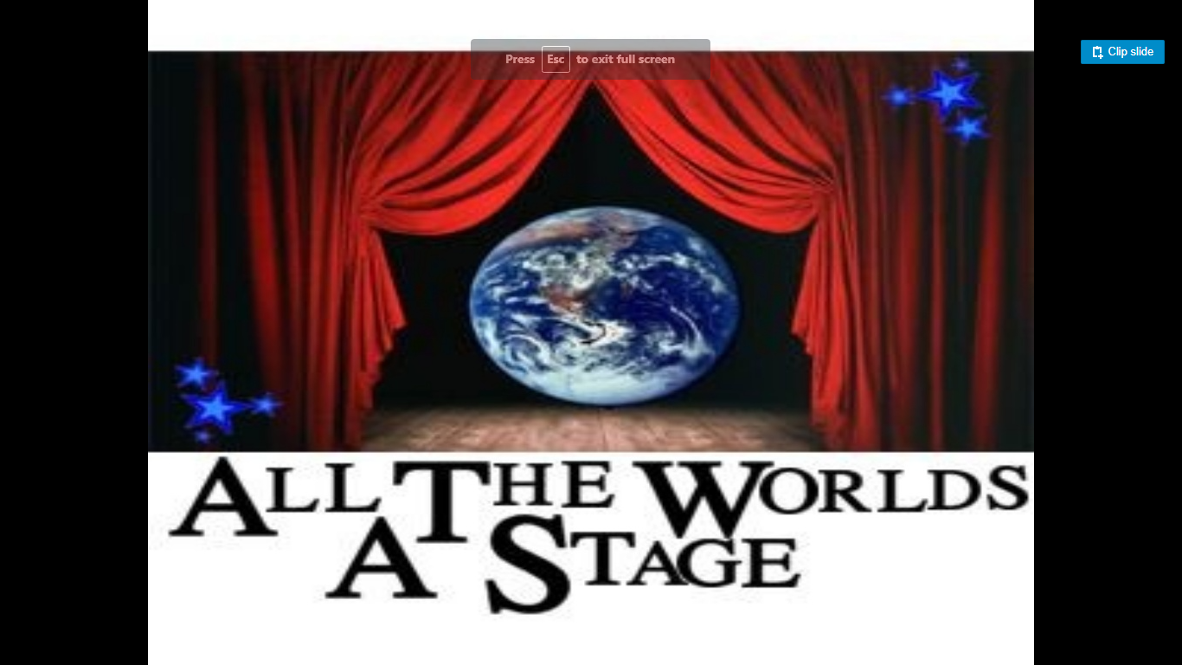
In Pictures:
[Page. 240]

Slide 10
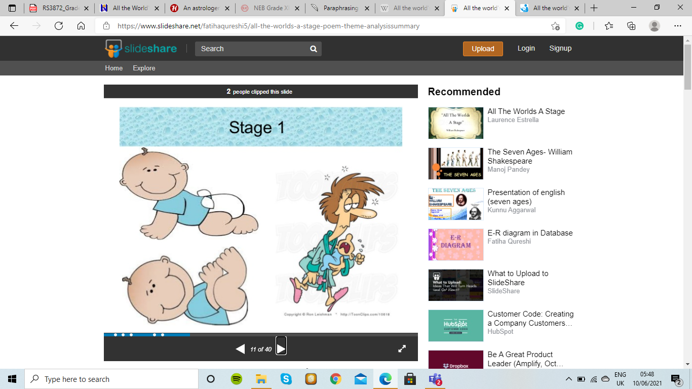
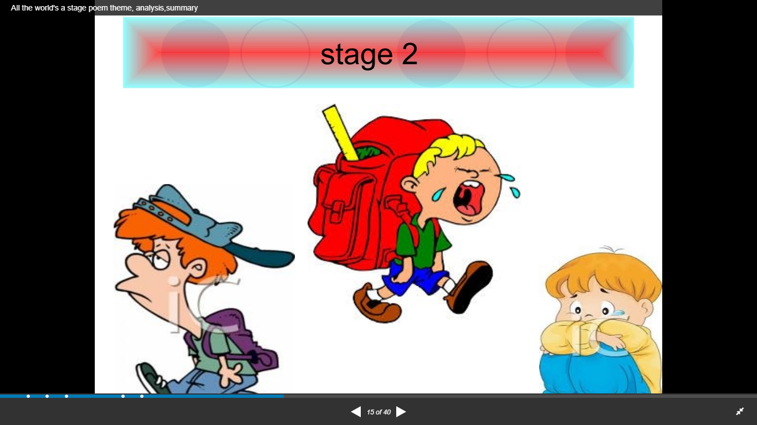
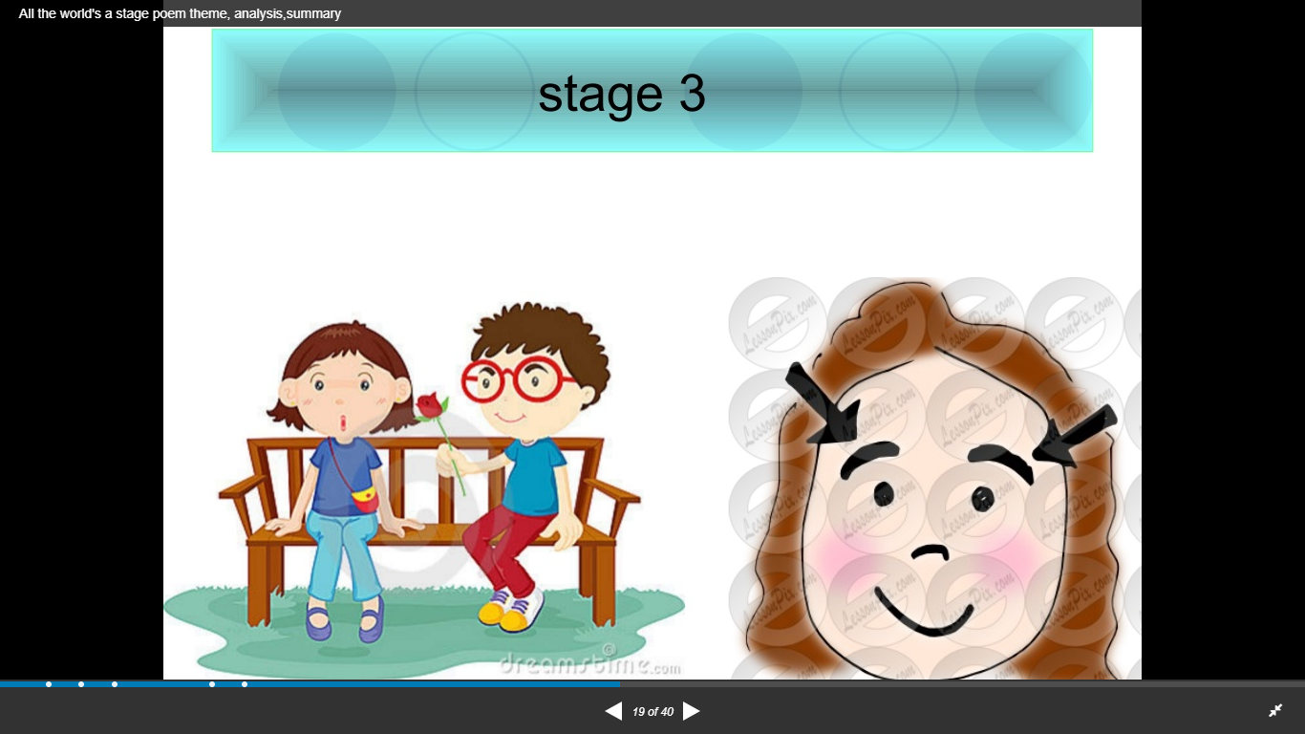
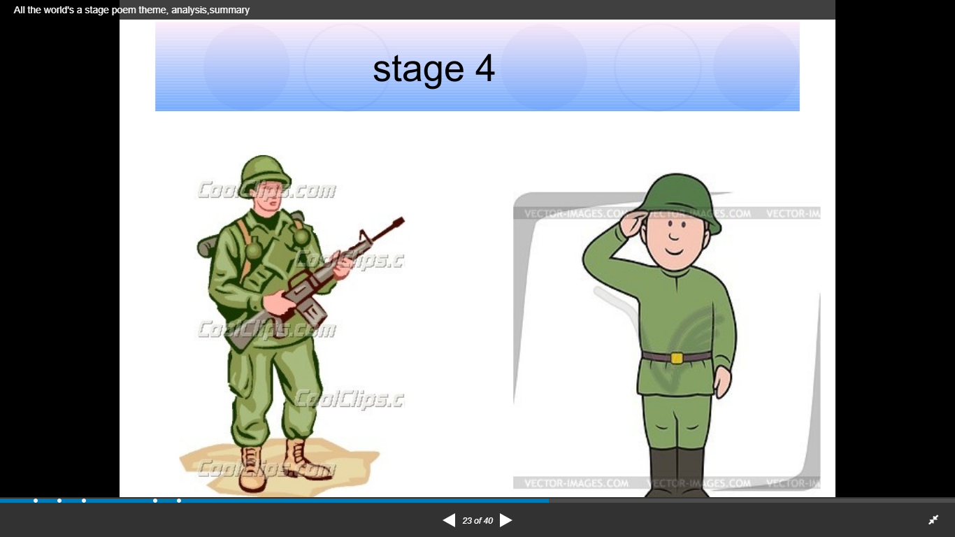
In Pictures:
[Page. 240]

Slide 11
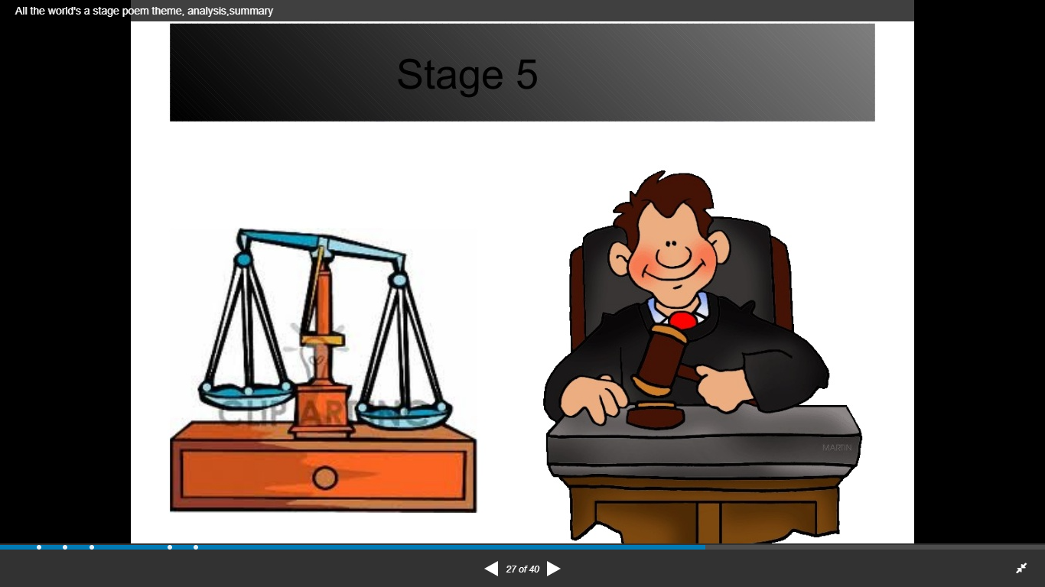
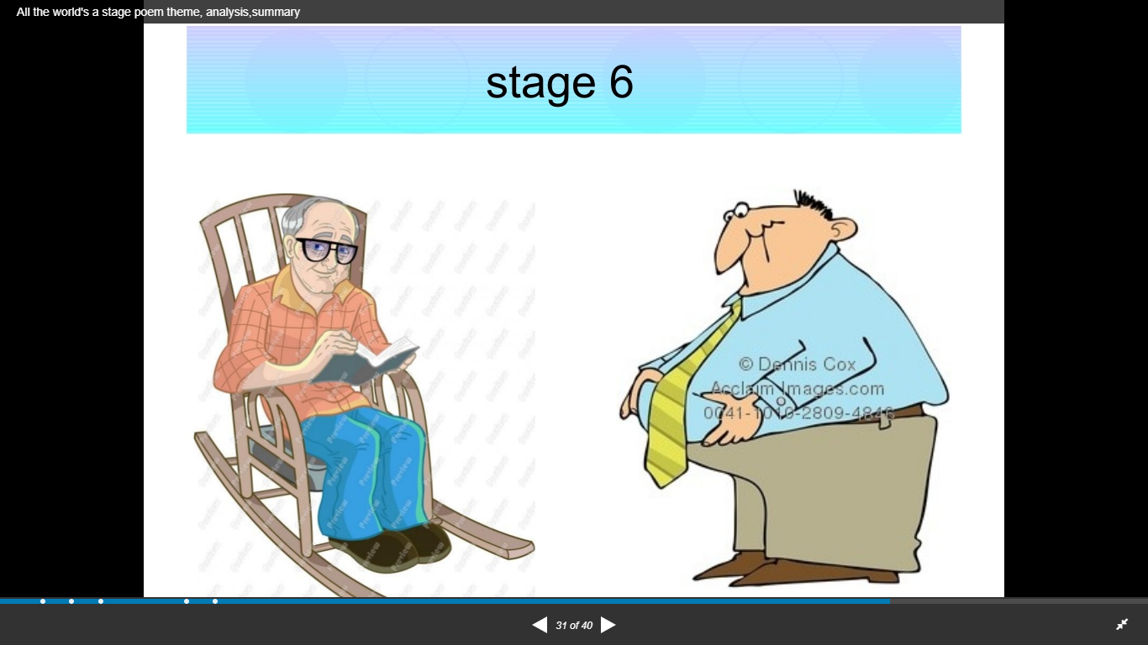
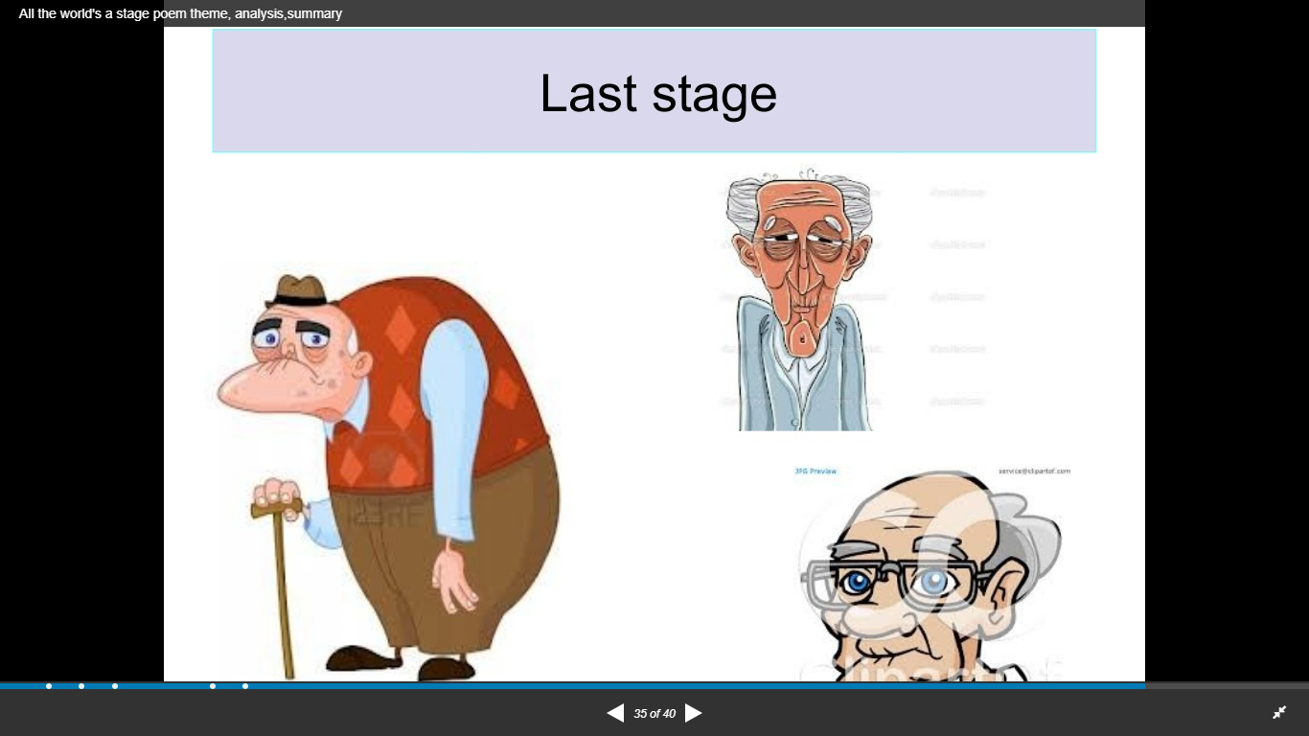
[Page. 240]

Slide 12
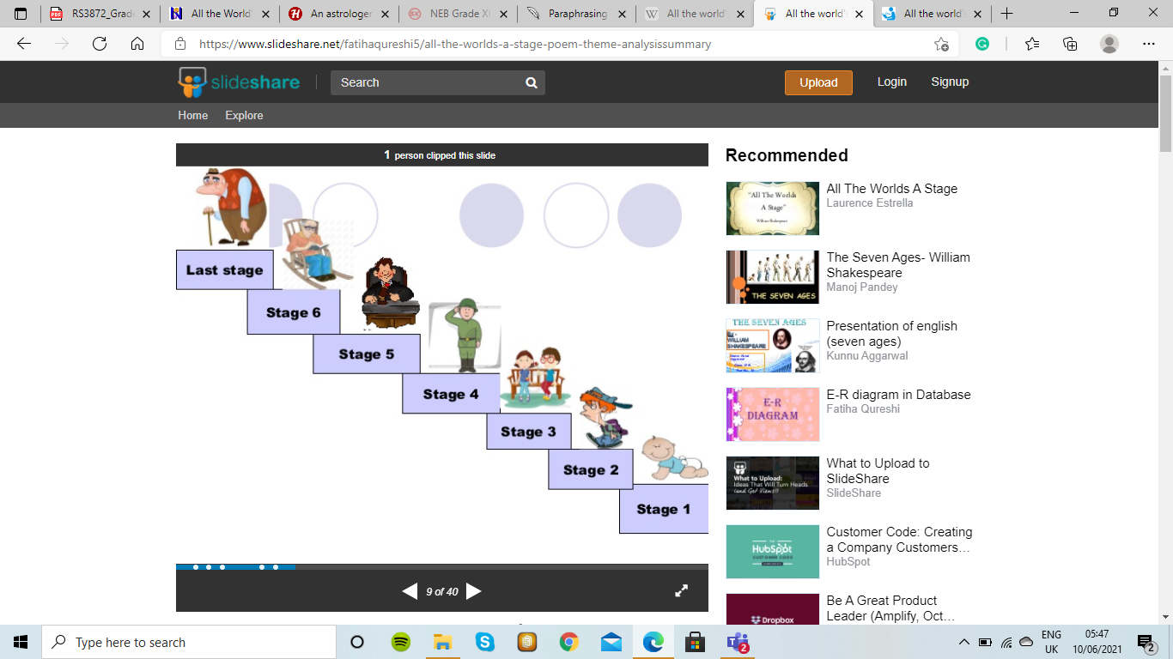
In Pictures:
[Page. 240]

Slide 13
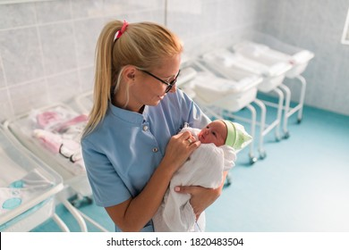
All the World’s a Stage.
All the world's a stage,
And all the men and women merely players;
They have their exits and their entrances,
And one man in his time plays many parts,
His acts being seven ages. At first, th e infant,
Mewling and puking in the nurse's arms.
Word-Meaning
Merely: only/just Puke (-ing): vomit
Infant: newly born baby Whine (-ing): complain
mew (-ing): cry Satchel: school bag
creep(-ing): to move slowly
EXPLANATION: Shakespeare says that each human being performs seven parts in this small drama on the stage of the world. He makes his entry as a baby who is fully dependent upon others. This stage ends when the infant grows into a school child.

Slide 14

Then the whining schoolboy, with his satchel
And shining morning face, creeping like snail
Unwillingly to school.
Word-Meaning
Whine (-ing): complain
mew (-ing): cry
Satchel: school bag
creep(-ing): to move slowly
Explanation:
The second stage is his boy-hood. This is his school going period. It is the time when he complains all the time. His face shines like the bright and fresh morning. He carries his school bag and unwillingly goes to school at the speed of an insect.

Slide 15
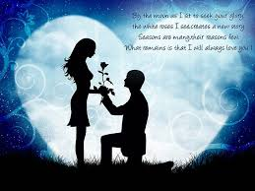
And then the lover,
Sighing like furnace, with a woeful ballad
Made to his mistress' eyebrow.
Word-Meaning
Sigh (-ing): to take deep breath
furnace: an oven
Woeful: bad/serious
Ballad: song/poem
Explanation:
This is the third stage of man’s life. Now he is a grown up person and assumes the form of a lover. It is the time when he loves his beloved passionately. He writes a song in praise of his beloved’s eye brow. He also sings such songs again and burns in his emotions

Slide 16
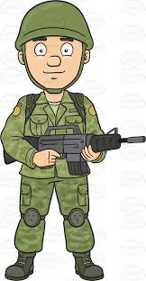
Then a soldier,
Full of strange oaths and bearded like the pard,
Jealous in honour, sudden and quick in quarrel,
Seeking the bubble reputation
Even in the cannon's mouth.
Word-Meaning
Oaths: promises/pledges pard: animal like a tiger
Bubble: temporary Reputation: fame
Cannon: gun
Explanation:
In these lines the poet shows the fourth stage of a man’s life. When he matures, he becomes a soldier. He takes strange oaths. He has a beard like a tiger or a leopard.
He is fierce like these animals. During this stage of life, man is jealous of honour of other. He is very quick- tempered and owns quarrels. Since he is warm-blooded, he looks for temporary reputation and fame. To achieve this temporary fame, he is even ready to go into the mouth of a gun. He does not bother for dangers .

Slide 17
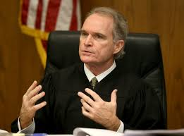
And then the justice,
In fair round belly with good capon lined,
With eyes severe and beard of formal cut,
Full of wise saws and modern instances;
And so he plays his part.
Word-Meaning
Belly: stomach/tummy
Capon: male chicken
Lined: packed
Saws: proverbs
Instances: examples
Explanation:
This is man's fifth stage of life. Here, the guy turns middle-aged and mature, as if he were a judge, with a fair round belly full of chicken flesh. At this stage, he speaks with a lot of proverbs from the past as well as instances from the present time. He is a man bearded with a formal cut.

Slide 18
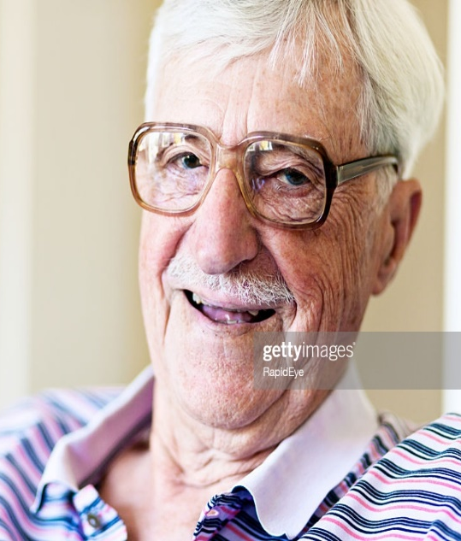
The sixth age shifts into the lean and slippered pantaloon,
With spectacles on nose and pouch on side;
His youthful hose, well saved, a world too wide
For his shrunk shank, and his big manly voice,
Turning again toward childish treble, pipes
And whistles in his sound.
Word-Meaning
Pantaloons: trousers Spectacles: glasses
Pouch: pocket Hose : trousers
Shrunk: contracted Shank: trunk (here, legs)
Manly: mannish/male Childish: child like
Treble : a child’s high voice Whistle : to make high, long sound
Explanation:
In the sixth line of the poem, the man enters the elderly act of life, as an old man requiring spectacles to aid his vision made weak with age, with the schoolboy satchel now replaced with a small pouch that is enough to carry all his humble old daily necessities.

Slide 19
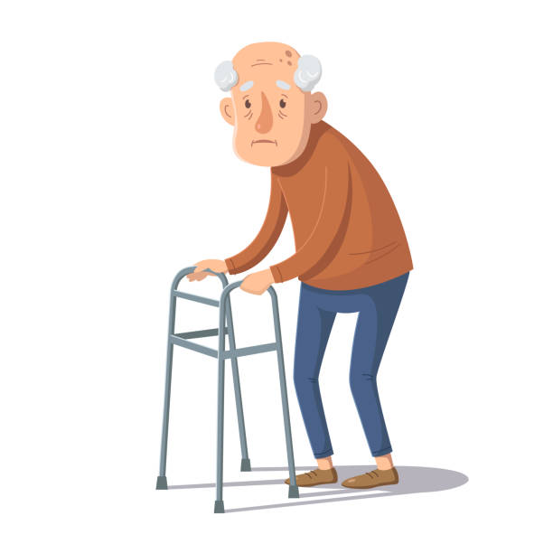
Last scene of all,
That ends this strange eventful history,
Is second childishness and mere oblivion,
Sans teeth, sans eyes, sans taste, sans everything.
Word-Meaning
Mere : simple/just
Oblivion: forgetfulness
Sans: without/lacking
Explanation:
This is the last stage of man’s life. Man becomes child once again. This is like his second childhood. In this stage he is childish as well as childlike. At this stage he forgets almost everything. His memory becomes very weak. He loses teeth, eye-sight and taste. He is without everything. This is the stage in which he completes the drama of his life and leaves the stage of this world for the next. und belly full of the meat of chickens.

Slide 20
Infancy (lines 5-6):
The first stage of man’s life is infantry. In the monologue, readers can find an image of a baby crying softly and throwing up in the caregiver’s lap.
Boyhood (lines 7-9):
The image of a school-going boy unwilling to go to school describes this stage.
Adolescence/Teenage (lines 9-11):
In this stage, Shakespeare presents an image of a dejected lover who composes sad songs for his beloved.
Youth (lines 11-15):
He projects the stage of youth by depicting the life of a soldier. As a soldier, a person in his youths is unafraid of dire challenges.
Middle Age (lines 15-19):
The fifth stage deals with middle age and it is described by the picture of a judge or one who practices law. In this stage of life, one starts to mature and becomes wiser than before.
Old Age (lines 19-25):
Just before the final stage, comes old age, turning the manly voice of youth into the childish trebles and whistling. It makes the body weak and the mind, dependent upon others.
Death (lines 25-28):
In the finale of this seven-act-play of life, the strange and eventful history ends abruptly. It leaves a man with nothing.

Slide 21
Analysis of the Poem
[Page. 240]
Structure and Form
Literary Devices
Structure and Form
‘All the world’s a stage’ is an extract from William Shakespeare’s well-loved play, As You Like It.
Specifically, it is a monologue that is spoken by the melancholy Jaques.
The monologue is twenty-eight lines long and is in part written in blank verse, or unrhymed pattern.
Notes:
A beat is best described as the pace, tempo or the timing that it takes to play a particular piece of music.

Slide 22
Contnd…
[Page. 240]
Literary Devices
We find the use of several literary devices in this poem. Some are:
Simile:
‘creeping like a snail”;
“soldier… bearded like the pard”; etc.
Metaphor:
All the world’s a stage.
Men and women are portrayed as players
Life is portrayed as the stage.
Repetition:
Another figure of speech used in this monologue; words like sans, age, etc. are repeated for the sake of emphasis.

Slide 23
Contnd…
[Page. 240]
Alliteration:
“his shrunk shank”;
“quick in quarrel”; etc.

Slide 24
Themes:
[Page. 240]
In ‘All the world’s a stage’ Shakespeare discusses the futility of humanity’s place in the world.
He explores themes of time, aging, memory, and the purpose of life.
Through the monologue, it is conveyed that everyone is simply a player in a larger game that they have no control over.
Shakespeare takes the reader through the stages of life, starting with infancy and childhood and ending up with an old man who has been a lover, a soldier, and a judge.
The “man” dies after reverting to a state that is close to childhood and infancy.

Slide 25
Contnd…
[Page. 240]
Conclusion:
Life is drama, the world is a stage and we human beings are actors. The theme hints at the greatest irony in the lives of human beings. Shakespeare over here has masterfully described the stages of human life. The use of imagery and of acting and stage is a recurrent one in Shakespeare.

Slide 26
Exercise
[Page. 240]
Understanding the text
Answer the following questions.
Why does the poet compare the world with a stage?
What is the first stage in a human’s life? In what sense can it be a troubling stage?
Describe the second stage of life based on the poem.
Why is the last stage called second childhood?
In what sense are we the players in the world stage?

Slide 27
Contnd…
[Page. 240]
Reference to the context
Explain the following lines:
All the world's a stage, And all the men and women merely players.
Explain the following lines briefly with reference to the context.
They have their exits and their entrances;
And one man in his time plays many parts.
Read the given lines and answer the questions that follow.
Then the whining schoolboy, with his satchel
And shining morning face, creeping like snail
Unwillingly to school.
Which stage of life is being referred to here by the poet?
Which figure of speech has been employed in the second line?
Who is compared to the snail?
Does the boy go to the school willingly?

Slide 28
Contnd…
Simile and metaphor are the two major poetic devices used in this poem. Explain citing examples of each.
Which style does the poet use to express his emotions about how he thinks that the world is a stage and all the people living in it are mere players?
What is the theme of this poem?
Reference beyond the text
Describe the various stages of a human’s life picturised in the poem “All the World’s a Stage.”
Is Shakespeare’s comparison of human’s life with a drama stage apt? How?

